Slide 1
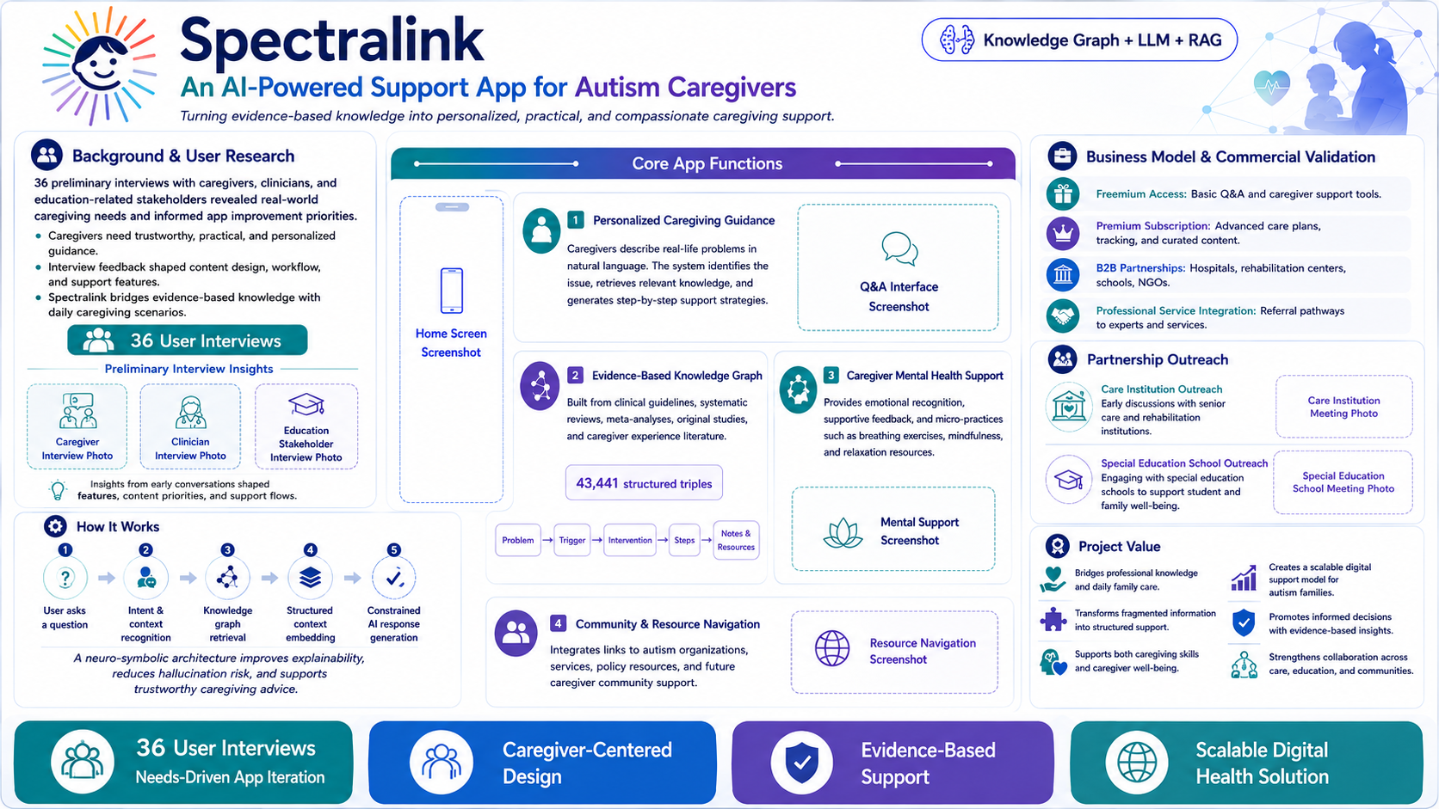
Notes:
3-Minute Presentation Script
Good morning everyone. We are Team SpectraLink, and today we are presenting an AI-powered support app for autism caregivers.
Caregivers of children with autism spectrum disorder often face complex and highly individualized daily challenges. These challenges may involve behavior management, communication difficulties, emotional regulation, school adaptation, and family stress. However, professional services are often limited by high costs, long waiting lists, geographic barriers, and shortages of trained specialists. As a result, many caregivers have to rely on fragmented information from books, social media, or general AI tools, which may not always be evidence-based, practical, or safe.
To better understand real-world needs, we conducted 36 preliminary interviews with caregivers, clinicians, and education-related stakeholders. These interviews showed that caregivers need guidance that is not only trustworthy, but also practical, personalized, and easy to apply in daily family life. Their feedback directly shaped our app design, including content priorities, user workflow, and support features.
This is where SpectraLink comes in. Our mission is to turn evidence-based autism knowledge into personalized, practical, and compassionate caregiving support.
Technically, SpectraLink uses a neuro-symbolic AI architecture, combining a knowledge graph, large language model, and retrieval-augmented generation. The knowledge graph is built from clinical guidelines, systematic reviews, meta-analyses, original studies, and caregiver experience literature. It currently includes 43,441 structured triples, organizing knowledge into relationships such as problems, triggers, interventions, steps, notes, and resources.
When a caregiver asks a question, the system first recognizes the user’s intent and context. It then retrieves relevant knowledge from the graph, embeds it into a structured context, and generates a constrained AI response. This workflow improves explainability, reduces hallucination risk, and supports more trustworthy advice.
SpectraLink has four core app functions.
First, it provides personalized caregiving guidance. Caregivers can describe real-life problems in natural language, and the app generates step-by-step support strategies.
Second, it offers an evidence-based knowledge graph, helping caregivers understand not only what to do, but also why the recommendation is reliable.
Third, it provides caregiver mental health support, including emotional recognition, supportive feedback, breathing exercises, mindfulness, and relaxation resources.
Fourth, it supports community and resource navigation, connecting families with autism organizations, services, policy resources, and future caregiver communities.
For commercialization, we are designing a sustainable and scalable model. Basic access will provide free Q&A and caregiver support tools. Premium subscription will offer advanced care plans, tracking, and curated content. We are also actively communicating with two types of potential partners: a care and rehabilitation institution and a special education school. These early partnership discussions help us validate real-world application scenarios and explore future B2B pathways in care, education, and family support.
Importantly, SpectraLink is positioned as a support tool, not a diagnostic or emergency intervention tool. When evidence is insufficient or risk-related content appears, the system will recommend referral to professionals.
In summary, SpectraLink bridges professional autism knowledge and daily family care. It is caregiver-centered, evidence-based, and commercially scalable. By transforming fragmented information into structured support, SpectraLink aims to empower caregivers, promote informed decisions, and create a scalable digital health solution for autism families.
Thank you.

